Slide 1
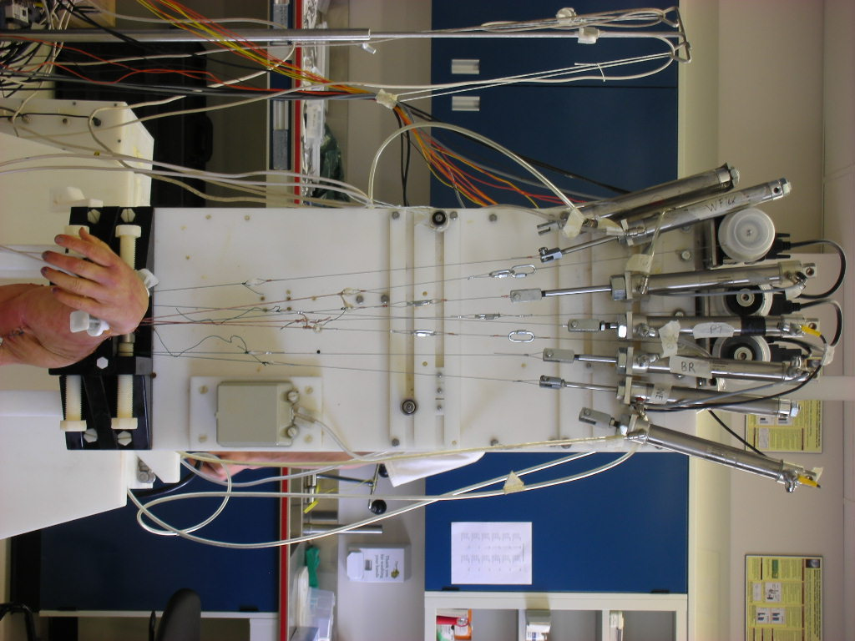
Elbow Motion Simulator

Slide 2
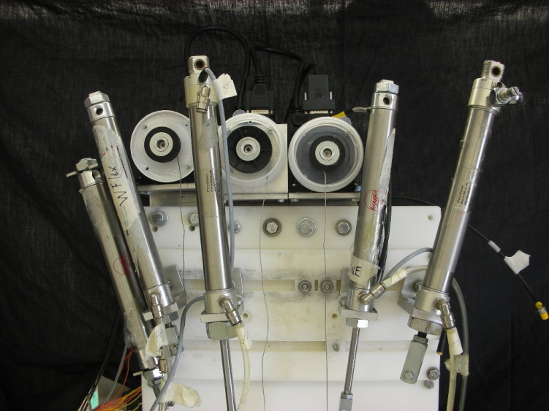
Muscle Actuation
Servo-motors actuate brachialis, biceps and triceps muscles
Pneumatic pistons apply loads to other muscles
Notes:
Servo-motors actuate Brachialis, Biceps and Triceps muscles.
Pneumatic pistons apply loads to other muscles.

Slide 3
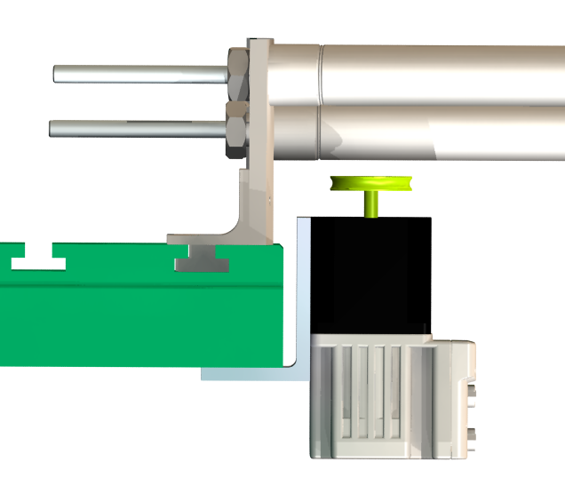
Muscle Tension Feedback
Tension feedback is achieved
with instrumented motor mounts
tension
Load sensing motor mounts
Simple cantilever design
moment

Slide 4
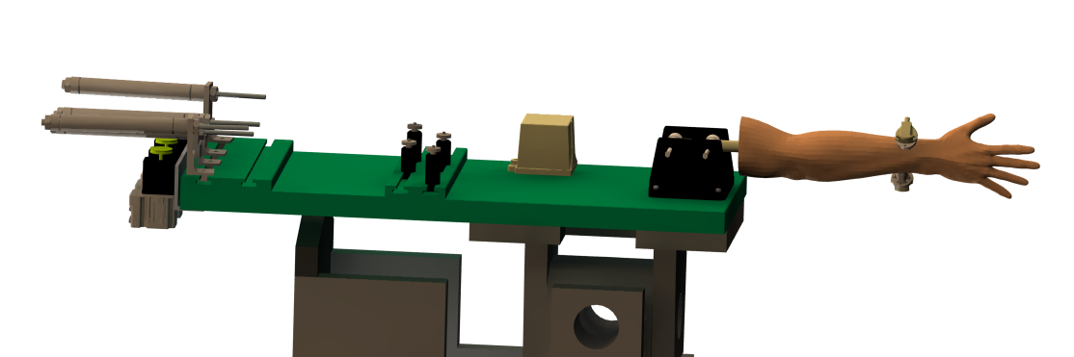
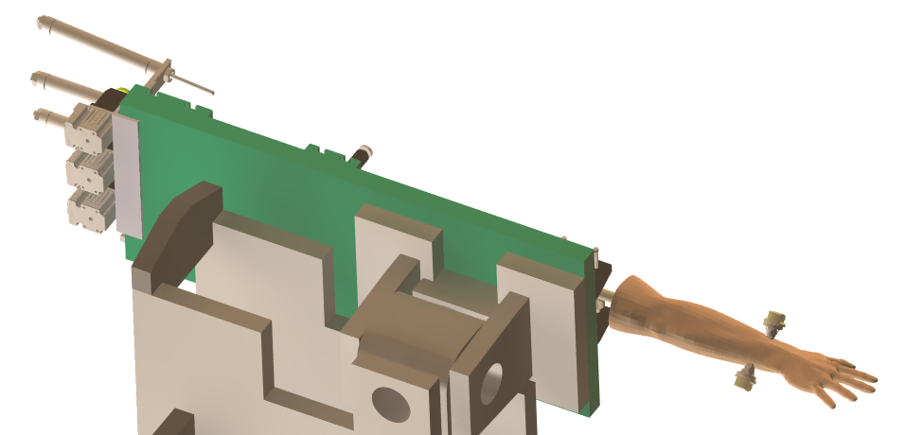
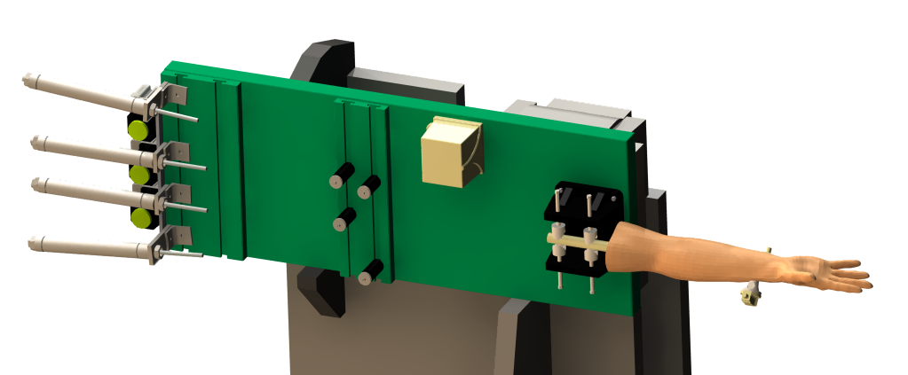
Other Simulator Positions
Horizontal
Varus
Valgus
Notes:
From horizontal, it can be rotated into varus and valgus.

Slide 5
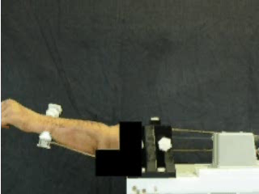
Horizontal Flexion

Slide 6
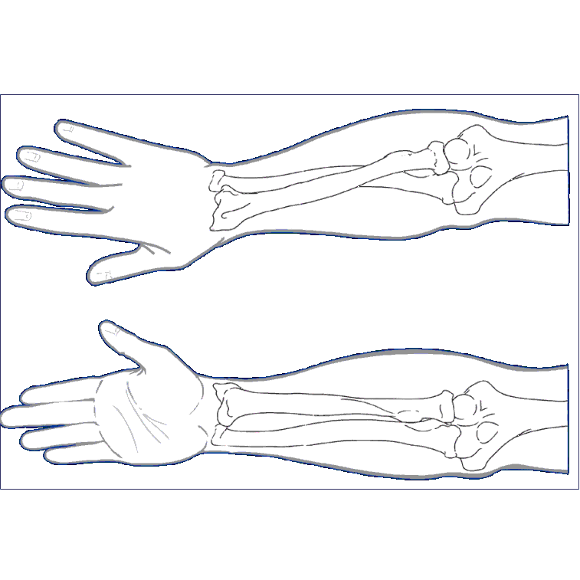
Kinematic Pathways
Valgus
Angulation
Notes:
valgus angulation of the ulna relative to the humerus

Slide 7


Valgus Angulation Pathways
Vertical
Valgus Angle (deg)
Flexion Angle (deg)
Active
Passive
Horizontal
Valgus Angle (deg)
Flexion Angle (deg)
Notes:
CHANGE TITLES

Slide 8


Valgus Angulation Pathways
Valgus
Valgus Angle (deg)
Flexion Angle (deg)
Active
Passive
Varus
Valgus Angle (deg)
Flexion Angle (deg)

